Slide 1

Azure architecture and services
AZ-900: Microsoft Azure Fundamentals

Slide 2
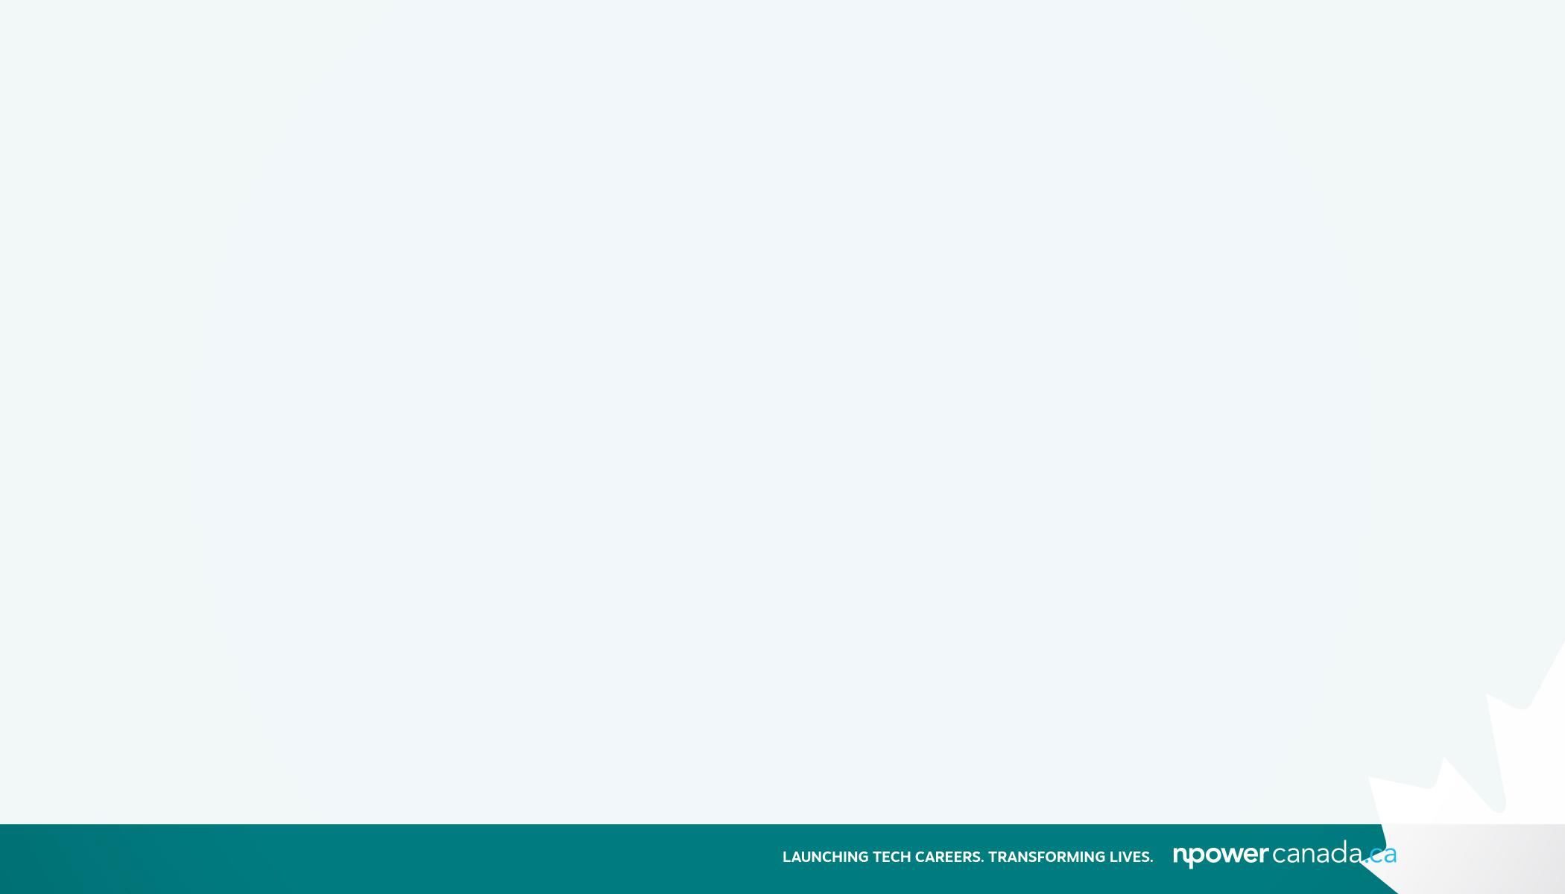
Exam objectives
Modules:
Describe the core architectural components of Azure
Describe Azure compute and networking services
Describe Azure storage services
Describe Azure identity, access, and security

Slide 3

Topic 1:
Describe the core architectural components of Azure
Describe Azure regional, regional pairs, and sovereign regions
Describe availability zones
Describe Azure datacenters
Describe Azure resources and resource groups
Describe subscriptions
Describe management groups
Describe the hierarchy of resource groups, subscriptions, and management groups

Slide 4
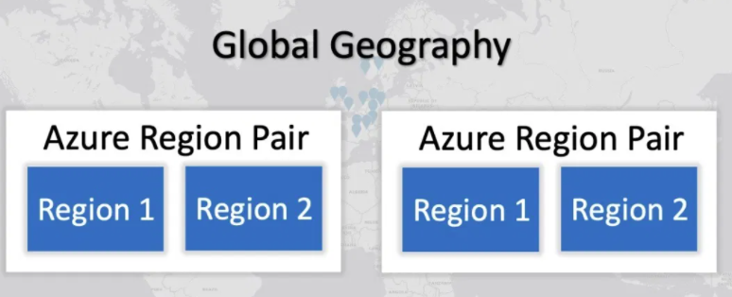
Azure regions and Azure region pairs
Microsoft Azure is generally available in many regions around the world (54 Azure regions available in 140 countries).
Clients will have to choose a specific Azure Region to host their services within. Specific Azure regions are paired together for disaster recovery purposes.

Slide 5
What are Azure Region Pairs?
An Azure Region Pair is a relationship between 2 Azure Regions within the same geographic region for disaster recovery purposes. If one of the regions were to experience a disaster or failure, then the services in that region will automatically fall over to that secondary region in the pair.
For example: North Central US region’s pair is South Central US
Azure regions in a pair have direct connections which bring additional benefits to use them together.
Each Azure Region in a pair is always located greater than 300 miles apart when possible.

Slide 6
What are the benefits to Azure Region Pairs
Due to geo-political, tax, law enforcement jurisdiction, compliance clients may require that their data be located within the bounds of a certain country. This is why both regions in Azure Region Pairs are located within same geographic region, mostly within the same country.
When rolling out the updates, Azure will update a single region in a pair first before moving on to the next region. This ensures minimal downtime in the vent of bugs, failures caused by updates.
In the event of massive Azure outage , each Azure Region Pair has a single region that is prioritized over the other for recovery.

Slide 7
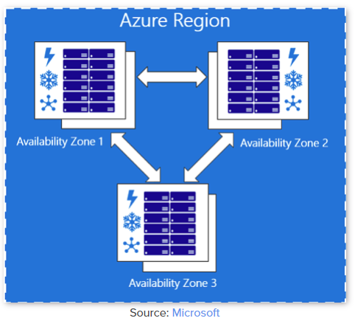
What are Availability Zones in Azure?
Azure Availability zones are separate data center units within Microsoft Azure, each with its own power, cooling and networking.
Running your services on multiple availability zones, makes your applications more resilient to failure in your primary data center.
An Azure region is a complex of Azure data centers located in a specific geographical location.

Slide 8
The spectrum of Azure High Availability Options
Here are 4 options to ensure a Virtual Machine is highly available:
Single VM: running a Virtual Machine (VM) on Azure with no replication.
Availability Sets: running a VM with one or more replicated copies on separate hardware within the same Availability Zone, providing resiliency against machine failure
Availability Zones: running a VM with one or more replicated copies on different Availability Zones, providing resiliency against data center failure.
Region Pairs: running a VM with one or more replicated copies on different Azure Regions (but always staying within the same geopolitical boundary, typically meaning the same country), protecting against natural disasters and large-scale outages.

Slide 9
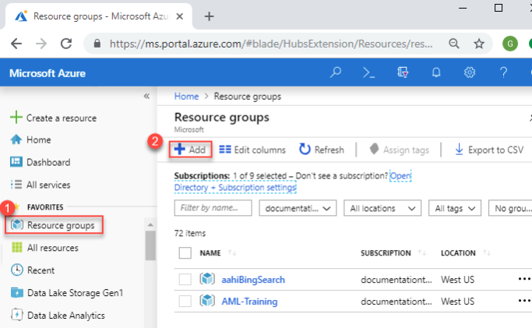
Azure Resource Groups
A resource group is a container that holds related resources for an Azure solution. The resource group can include all the resources for the solution, or only those resources that you want to manage as a group.
Adding resources that share the same lifecycle to the same resource group so you can easily deploy, update, and delete them as a group.

Slide 10
Azure Subscription
A subscription refers to the logical entity used to provision resources in Azure. it holds the details of all your resources like VMs, DB, etc.
A subscription groups together user accounts and the resources that have been created by those user accounts. For each subscription, there are limits or quotas on the amount of resources that you can create and use. Organizations can use subscriptions to manage costs and the resources that are created by users, teams, or projects.
There are 3 types: Free, pay-as-you-go and member offers

Slide 11
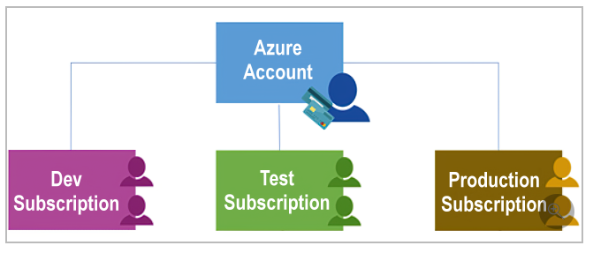
Azure Subscription (cont’d)
Azure subscriptions to define boundaries around Azure products, services, and resources:
Billing boundary
Access control boundary

Slide 12
Azure Management Groups
If your organization has many subscriptions, you might need a way to efficiently manage access, policies, and compliance for those subscriptions. Azure management groups provide a level of scope above subscriptions. Subscriptions are organized into containers called management groups.

Slide 13
LAB ( 20 minutes) - Create Azure Account
Create an Azure Account here and explore different Azure resources available with your type of account
Submit a screenshot to the Instructor

Slide 14
What is the Learn sandbox?
Learn exercises use a technology called the sandbox, which creates a temporary subscription that's added to your Azure account.
This temporary subscription allows you to create Azure resources for the duration of a Learn module. Learn automatically cleans up the temporary resources for you after you've completed the module.
The sandbox is the preferred method to use though, because it allows you to create and test Azure resources at no cost to you.
Access the Sandbox

Slide 15
Topic 2:
Describe Azure compute and networking services
Compare compute types, including container instances, virtual machines (VMs), and functions
Describe VM options, including Azure Virtual Machines, Azure Virtual Machine Scale Sets, availability sets, and Azure Virtual Desktop
Describe resources required for virtual machines
Describe application hosting options, including the Web Apps feature of Azure App Service, containers, and virtual machines
Describe virtual networking, including the purpose of Azure Virtual Networks, Azure virtual subnets, peering, Azure DNS, Azure VPN Gateway, and Azure ExpressRoute
Define public and private endpoints

Slide 16
Group Activity - 20 mins
Topic 1: Azure Virtual Machines (definition, resources)
Topic 2: Azure Virtual Machine Scale Sets
Topic 3: Azure Virtual Machine Availability sets
Topic 4: Azure Virtual Desktop

Slide 17
Azure compute services
Virtual machines are software emulations of physical computers. They include a virtual processor, memory, storage, and networking resources. VMs host an operating system, and you can install and run software just like a physical computer.
Azure virtual machines provides infrastructure as a service (IaaS)
Virtual machine scale sets are an Azure compute resource that you can use to deploy and manage a set of identical VMs.
Containers and Kubernetes are Azure compute resources that you can use to deploy and manage containers. Containers are lightweight, virtualized application environments.

Slide 18
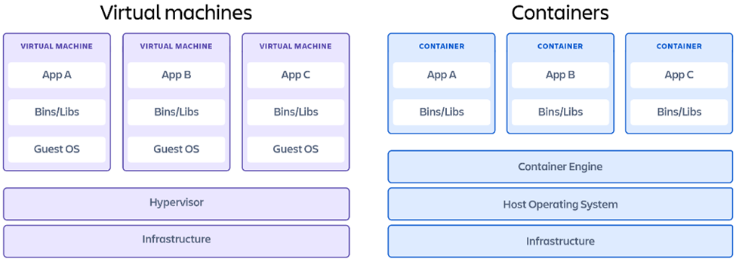
Virtual Machines VS Containers
The key differentiator between containers and virtual machines is that virtual machines virtualize an entire machine down to the hardware layers and containers only virtualize software layers above the operating system level.
What is Hypervisor?
www.atlassian.com/microservices/cloud-computing/containers-vs-vms#

Slide 19
Azure compute services(cont’d)
Windows Virtual Desktop: is a desktop and application virtualization service that runs on the cloud. It enables your users to use a cloud-hosted version of Windows from any location. Windows Virtual Desktop works across devices like Windows, Mac, iOS, Android, and Linux.
Azure Marketplace: Azure Marketplace is an online store that contains thousands of IT software applications and services built by industry-leading technology companies. In Azure Marketplace you can find, try, buy, and deploy the software and services you need to build new solutions and manage your cloud infrastructure.

Slide 20
What is Serverless computing
In understanding the definition of serverless computing, it's important to note that servers are still running the code. The serverless name comes from the fact that the tasks associated with infrastructure provisioning and management are invisible to the developer.
developers are able to increase their focus on the business logic and deliver more value to the core of the business.
Serverless computing helps teams increase their productivity and bring products to market faster.

Slide 21
Azure compute services(cont’d)
Azure App Service: you can quickly build, deploy, and scale enterprise-grade web, mobile, and API apps running on any platform
Azure Functions: ideal when you're concerned only about the code running your service and not the underlying platform or infrastructure. They're commonly used when you need to perform work in response to an event
Azure Logic Apps: Logic apps are similar to functions. Both enable you to trigger logic based on an event. Where functions execute code, logic apps execute workflows that are designed to automate business scenarios

Slide 22
References:
https://docs.microsoft.com/en-us/learn/modules/azure-database-fundamentals/
https://www.youtube.com/watch?v=gIhf-S7BCdo&list=PLGjZwEtPN7j-Q59JYso3L4_yoCjj2syrM&index=10
https://www.linkedin.com/learning/paths/prepare-for-the-azure-fundamentals-certification-az-900

